Slide 1



API Development for Forecasting Solar Power Generation Using Weather Data
THE 33rd JOINT CONFERENCE ON COMMUNICATIONS AND INFORMATION
Presented by :
Muhammad Miftah Faridh
Department of Electronics Engineering
Kookmin University

Slide 2

Outline
General Overview
Motivation & Contribution
Methodology
System Overview
Result & Discussion
Conclusion

Slide 3

General Overview
Reliance on fossil fuels may lead to an energy crisis due to pollution and greenhouse gas emissions, making them unreliable as future energy sources. This creates challenges in finding cleaner and sustainable energy sources to meet future demands, such as solar and wind energy. However, these weather-dependent sources carry uncertainties in power production, with solar power being affected by weather conditions and cloud cover, impacting power dispatch. [1][2][3]
To address the challenge of predicting solar irradiance for solar energy potential, models such as multi-regression and Artificial Neural Networks (ANN) have been developed. ANN, in particular, is gaining popularity in renewable energy forecasting as it can overcome limitations of time series models. ANN is a self-learning network that uses historical data to predict future values and is organized in layers with inputs at the bottom and outputs at the top. [4][5]
This research aims to use advanced ANN models, including LSTM, Bi-LSTM, RNN, and ConvLSTM, to forecast solar power generation using plant data and weather information. A Flask-based REST API will be created for output predictions, reducing deviations in solar power production and maintaining reliability with accurate forecasting from advanced ANN models. [5][2]

Slide 4
Motivation & Contribution
Weather & Energy Data
Comparison Model
Forecast Model
Rest API
The motivation of this paper is to develop a predictive model for forecasting solar power generation using weather data.
Based on the background we can get that , accurate forecasting tools can help reduce deviations and maintain reliability in solar power generation, aiding investment decisions and distribution system planning.

Slide 5
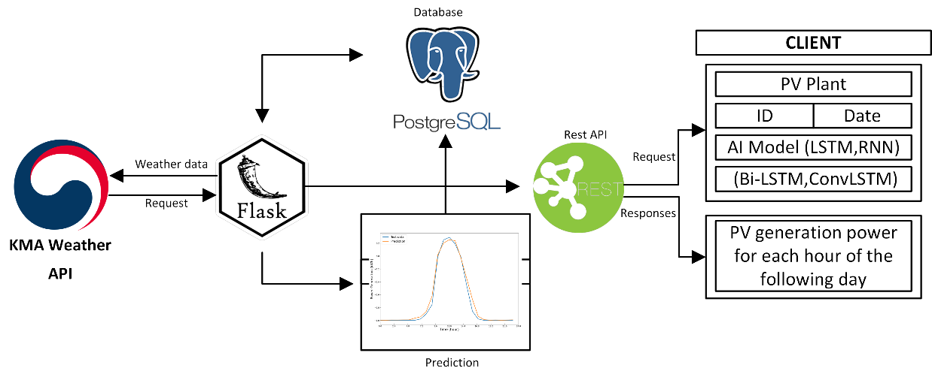
Methodology
We collect PV sites in many regions of Korea, including Busan, Seoul, Gyeonggi, Gangwon, Daejeon, Gyeongnam, Jeonbuk, Sejong, Chungbuk, and Chungnam, for the production of solar power electrical statistics.
The data is then sent to the database via MQTT.
We require weather data to train the model; this data is available via the open API of the Korea Meteorological Administration (KMA). The data we collect is hourly data for the entire year of 2021.
Fig. 1. System Overview

Slide 6
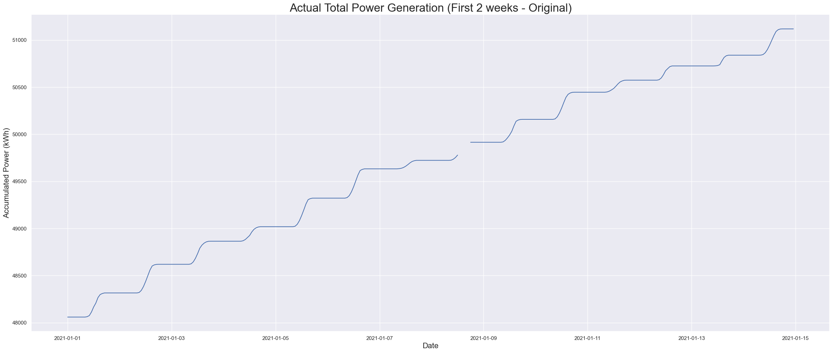

System Overview
Data Preprocessing
Interpolate Missing value using interpolation with nearest method.

Slide 7
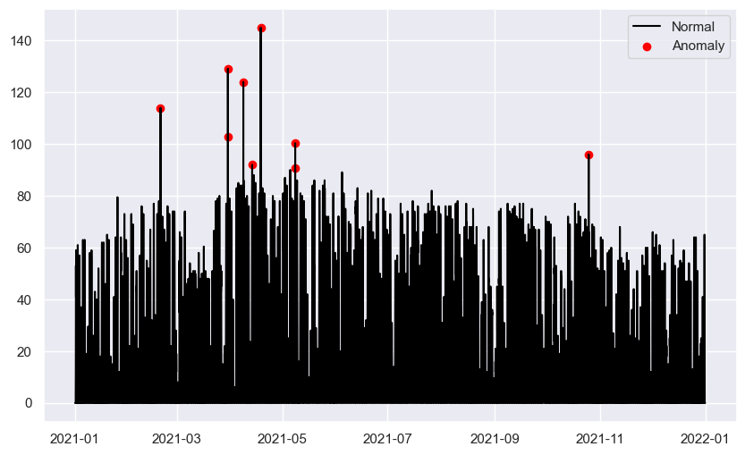
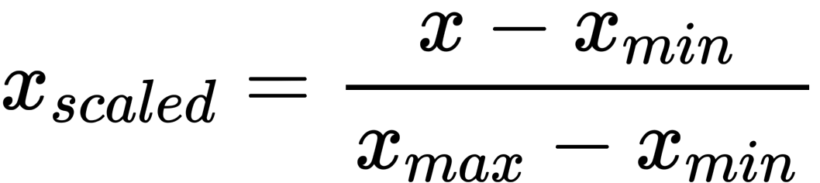
System Overview
Data Preprocessing
Deletion the outlier data and replace with nearest data
Then, the data are normalized using the MinMax method, the -1 to 1 rescaling approach

Slide 8
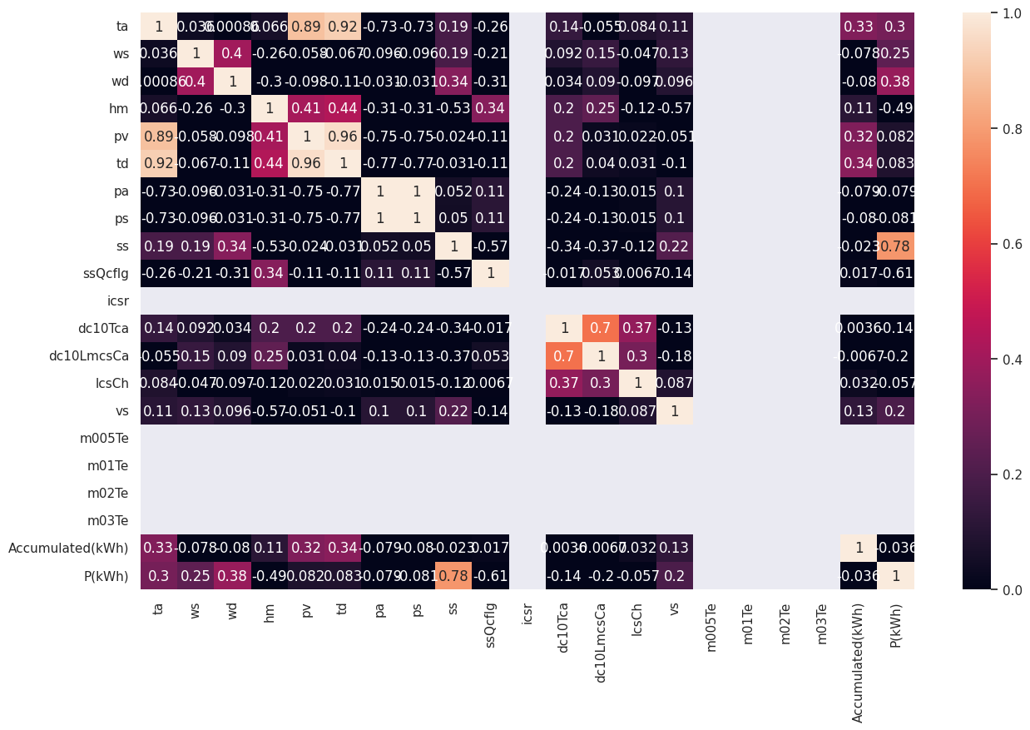
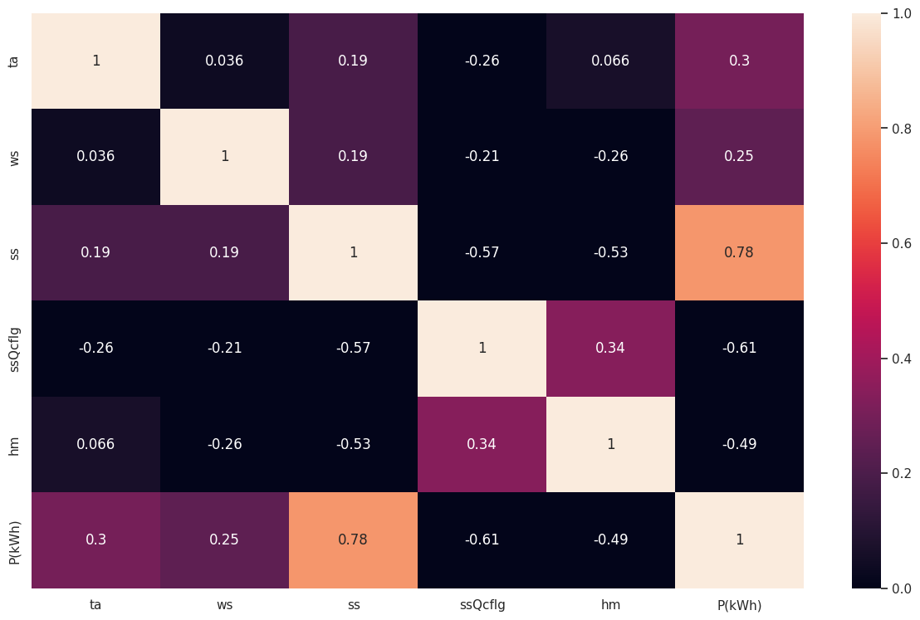
System Overview
Data Preprocessing
Correlation checking uses a correlation matrix and takes features that have the highest correlation, and we get temperature, relative humidity, solar radiation, sunshine in seconds per hour, and precipitation per hour as the highest correlation

Slide 9
System Overview
Data Preprocessing
1 Month Data
1 Week
Test Data
Windows
We used 1 Month data to predict 1 week future data

Slide 10
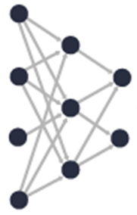
System Overview
Deep learning model based on Power Generation forecasting
Weather Data
Pre Processing
Forecast Trained Model
Power Generation Data
LSTM, Bi-LSTM, Stacked Bi-LSTM, RNN, and GRU.
We set the batch size to 32, the hyperparameter Adam as the optimizer with a learning rate of 0.001, the iteration to 200, and the callback function to terminate if the data has already reached convergence or is close to overfitting.

Slide 11



System Overview
Deep learning model based on Power Generation forecasting
We present several findings regarding the predicted timeliness of time series data. Loss, validation loss, and mean square error (MSE) are the essential measures for evaluating a model's quality. The RMSE, the mean absolute error (MAE), and the regression score (R-squared or R2 score) were used to evaluate the accuracy of the predictions. We use above equation to determine the error metrics.

Slide 12
Result and Discussion
Region | Model | MSE | MAE | R2 Score
Busan | LSTM | 0.0135 | 0.0556 | 0.9574
 | Bi-LSTM | 0.0146 | 0.0564 | 0.9513
 | Stacked Bi-LSTM | 0.014 | 0.0553 | 0.9560
 | RNN | 0.0225 | 0.1007 | 0.9178
 | GRU | 0.0171 | 0.0656 | 0.9459
Seoul | LSTM | 0.0086 | 0.055 | 0.9256
 | Bi-LSTM | 0.009 | 0.0529 | 0.9386
 | Stacked Bi-LSTM | 0.0076 | 0.0385 | 0.9462
 | RNN | 0.0161 | 0.0759 | 0.8966
 | GRU | 0.0085 | 0.0479 | 0.9361
Gyeonggi | LSTM | 0.0063 | 0.0406 | 0.9527
 | Bi-LSTM | 0.007 | 0.0434 | 0.9488
 | Stacked Bi-LSTM | 0.0062 | 0.0419 | 0.9433
 | RNN | 0.0096 | 0.0672 | 0.8978
 | GRU | 0.0058 | 0.0384 | 0.9503
Gangwon | LSTM | 0.0145 | 0.0599 | 0.9465
 | Bi-LSTM | 0.0178 | 0.0663 | 0.9246
 | Stacked Bi-LSTM | 0.0125 | 0.0491 | 0.9534
 | RNN | 0.0159 | 0.0661 | 0.9389
 | GRU | 0.0143 | 0.0593 | 0.9466
Daejon | LSTM | 0.0127 | 0.0593 | 0.9215
 | Bi-LSTM | 0.0127 | 0.0596 | 0.9333
 | Stacked Bi-LSTM | 0.0118 | 0.0584 | 0.9282
 | RNN | 0.0169 | 0.0756 | 0.8798
 | GRU | 0.0129 | 0.0589 | 0.9293
Gyeongnam | LSTM | 0.0109 | 0.0543 | 0.939
 | Bi-LSTM | 0.0104 | 0.0484 | 0.9459
 | Stacked Bi-LSTM | 0.013 | 0.0593 | 0.9162
 | RNN | 0.0121 | 0.0653 | 0.9269
 | GRU | 0.0111 | 0.0548 | 0.9345
Jeonbuk | LSTM | 0.0161 | 0.0618 | 0.9352
 | Bi-LSTM | 0.0155 | 0.0587 | 0.9394
 | Stacked Bi-LSTM | 0.0153 | 0.0558 | 0.9423
 | RNN | 0.019 | 0.0753 | 0.9217
 | GRU | 0.0161 | 0.0635 | 0.939
Sejong | LSTM | 0.0159 | 0.0642 | 0.9409
 | Bi-LSTM | 0.0155 | 0.0623 | 0.9442
 | Stacked Bi-LSTM | 0.0148 | 0.0573 | 0.9471
 | RNN | 0.0217 | 0.0788 | 0.9167
 | GRU | 0.0157 | 0.0633 | 0.9463
Chungbuk | LSTM | 0.0181 | 0.0714 | 0.885
 | Bi-LSTM | 0.0182 | 0.0678 | 0.8867
 | Stacked Bi-LSTM | 0.0176 | 0.0598 | 0.8982
 | RNN | 0.0242 | 0.0815 | 0.8254
 | GRU | 0.0185 | 0.0695 | 0.8869
Chungnam | LSTM | 0.0099 | 0.0498 | 0.945
 | Bi-LSTM | 0.0095 | 0.0478 | 0.9453
 | Stacked Bi-LSTM | 0.0092 | 0.0441 | 0.9507
 | RNN | 0.0113 | 0.06 | 0.9413
 | GRU | 0.0104 | 0.0576 | 0.9368
The predictions made by five deep learning models and ten regions are displayed in Table 1. The table indicates that the stacked BiLSTM achieves the best performance in all regions. GRU is the second-best model for deep learning, followed by BiLSTM, LSTM, and RNN. Compared to other deep learning models, the stacked BiLSTM has the highest performance because of its architecture, which consists of many layers of BiLSTM.

Slide 13
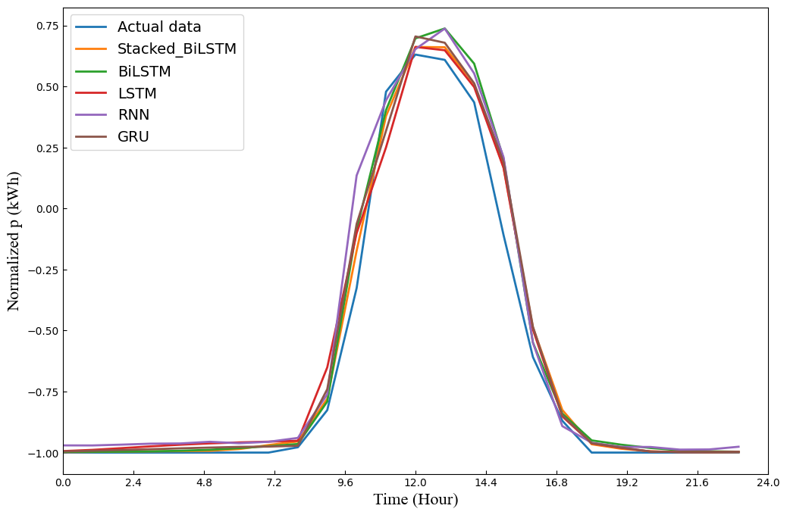
Result and Discussion
Prediction Model vs Actual Data

Slide 14
Conclusions
This work provides a comparison model employing 10 data regions in South Korea with fairly decent findings.
Stacked Bi-LSTM with a single dense layer achieves excellent performance in eight out of ten regions, particularly in the MSE and MAE performance sections.
In the future, we will investigate offering a technique that uses spatial-temporal analysis to produce new predictions using only data from the closest city.

Slide 15
Acknowledgment
This work was partly supported by the Technology Development Program of MSS (S3098815) and the MSIT (Ministry of Science and ICT), Korea, under the ITRC(Information Technology Research Center) support program (IITP-2022-2018-0-01396) supervised by the IITP(Institute for Information & Communications Technology Planning & Evaluation).

Slide 16
Thank you

